Slide 1
Design Patterns of Microservices

Slide 2
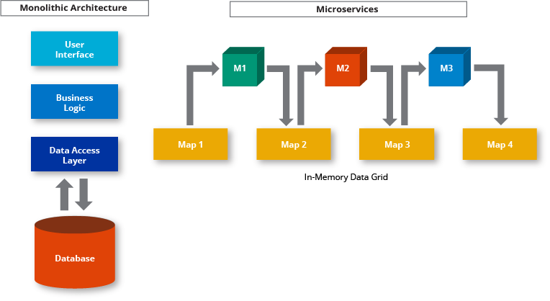
How Do Microservices Architectures Work?
Microservices Architecture Diagram:
Microservices Architecture vs Monolithic Architecture

Slide 3
Principles Used to Design Microservice Architecture
Independent & Autonomous Services
Scalability
Decentralization
Resilient Services
Real-Time Load Balancing
Availability
Continuous delivery through DevOps Integration
Seamless API Integration and Continuous Monitoring
Isolation from Failures
Auto-Provisioning

Slide 4
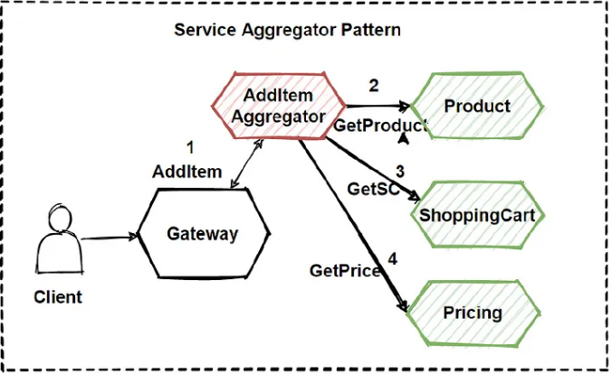
Aggregator

Slide 5
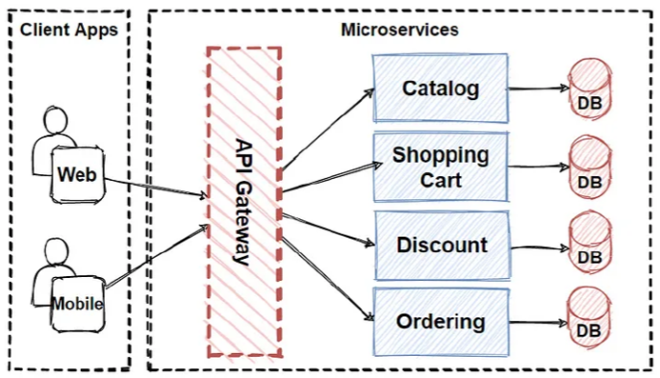
API Gateway

Slide 6
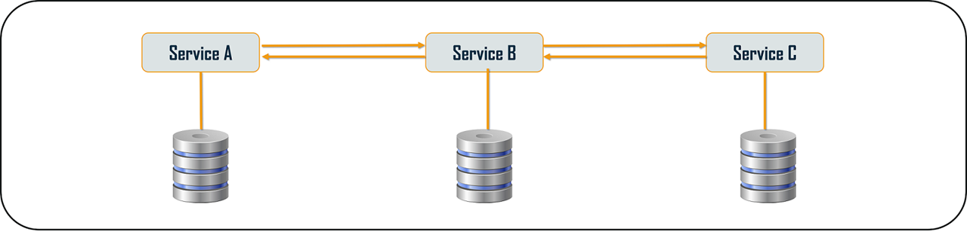
Chained or Chain of Responsibility

Slide 7
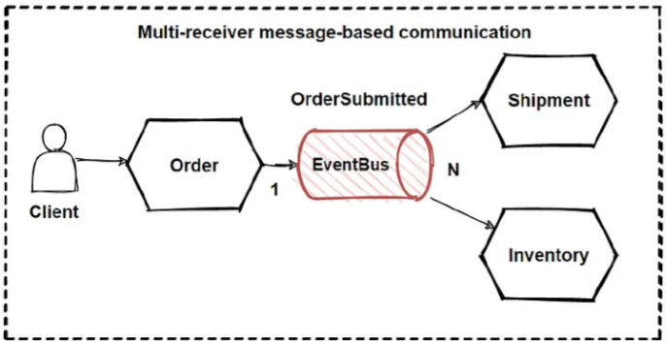
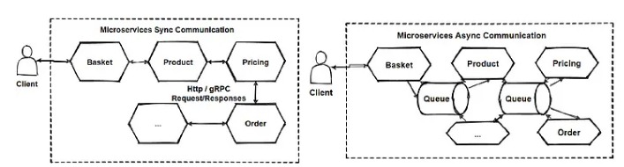
Asynchronous Messaging

Slide 8
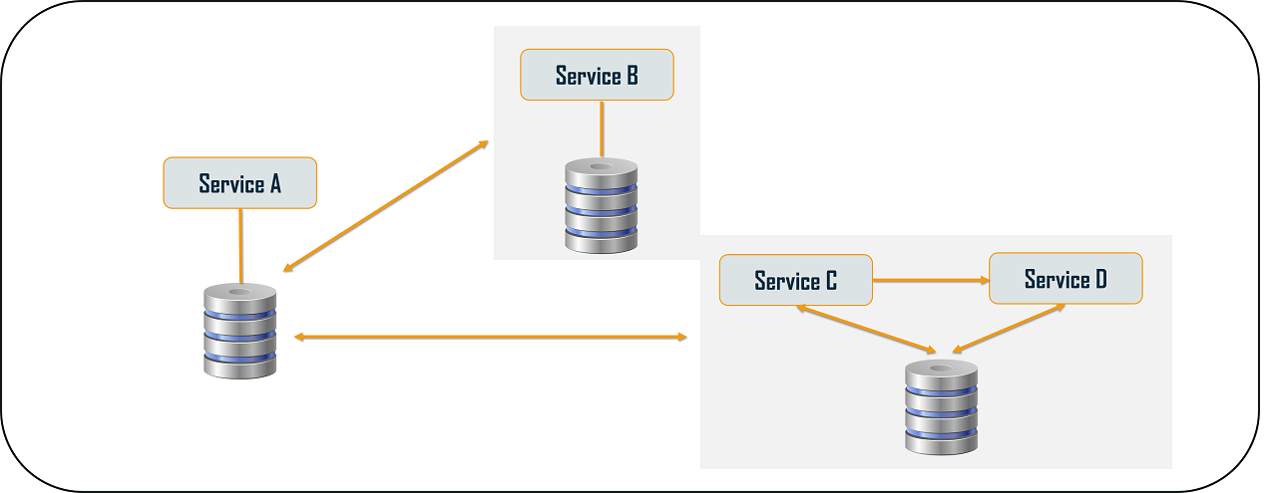
Database or Shared Data

Slide 9
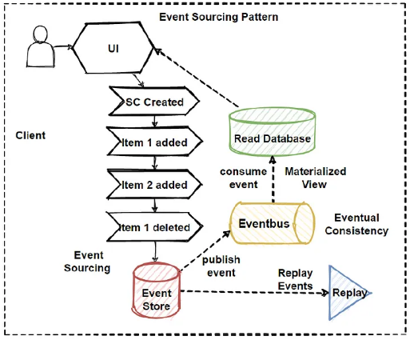
Event Sourcing

Slide 10
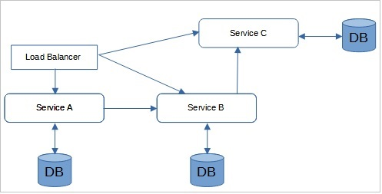
Branch

Slide 11
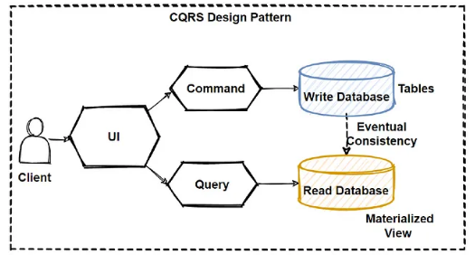
Command Query Responsibility Segregator

Slide 12
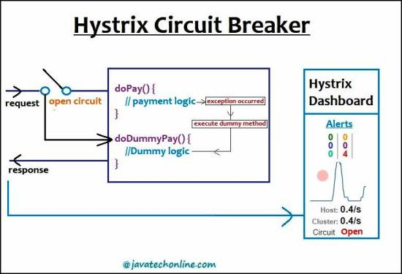
Circuit Breaker

Slide 13
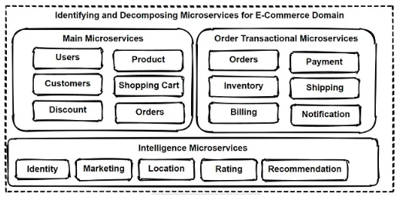
Decomposition

Slide 14

Bulkhead Pattern

Slide 15
Bulkhead Pattern

Slide 16
Bulkhead Pattern

Slide 17
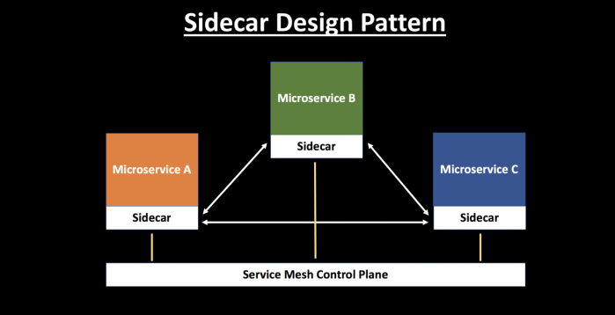
Sidecar Pattern

Slide 18
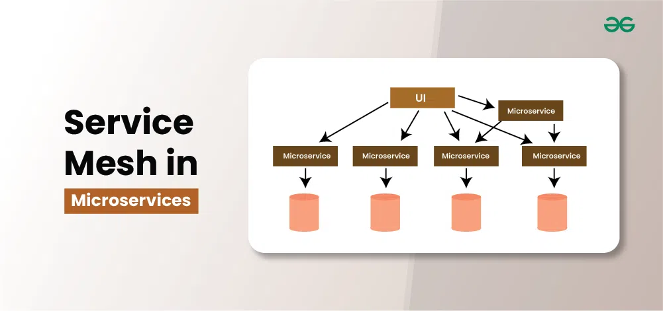
Service Mesh

Slide 19
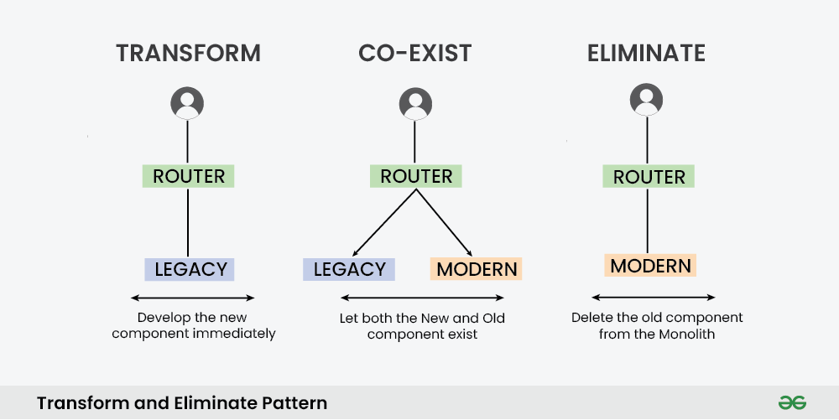
Strangler Pattern

Slide 20
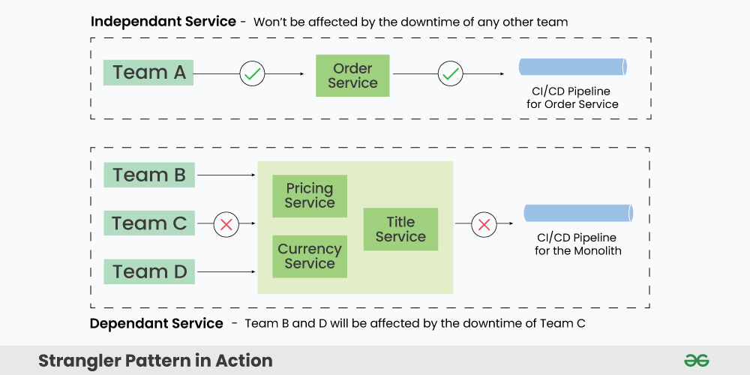
Strangler Pattern

Slide 21
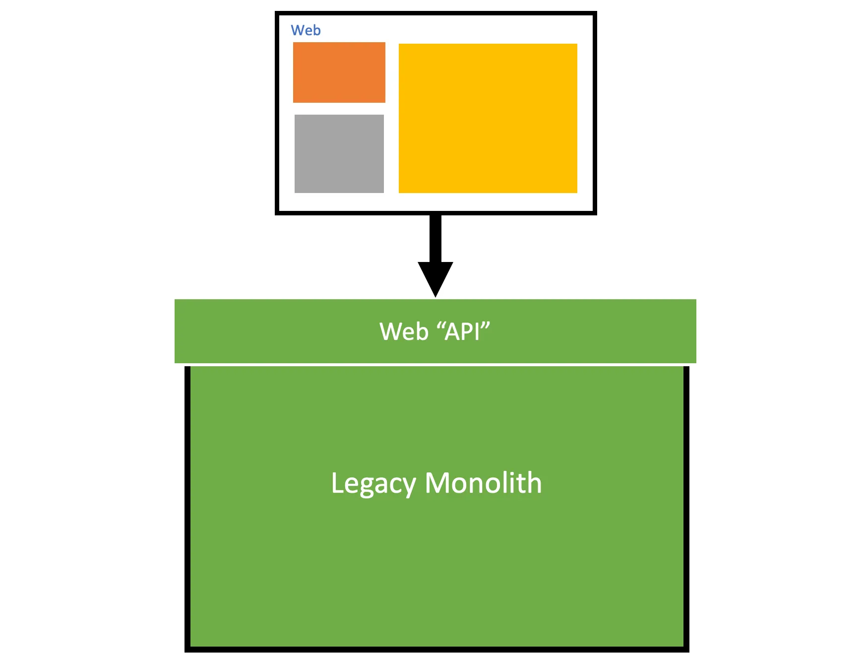
Backend for frontend (BFF)

Slide 22
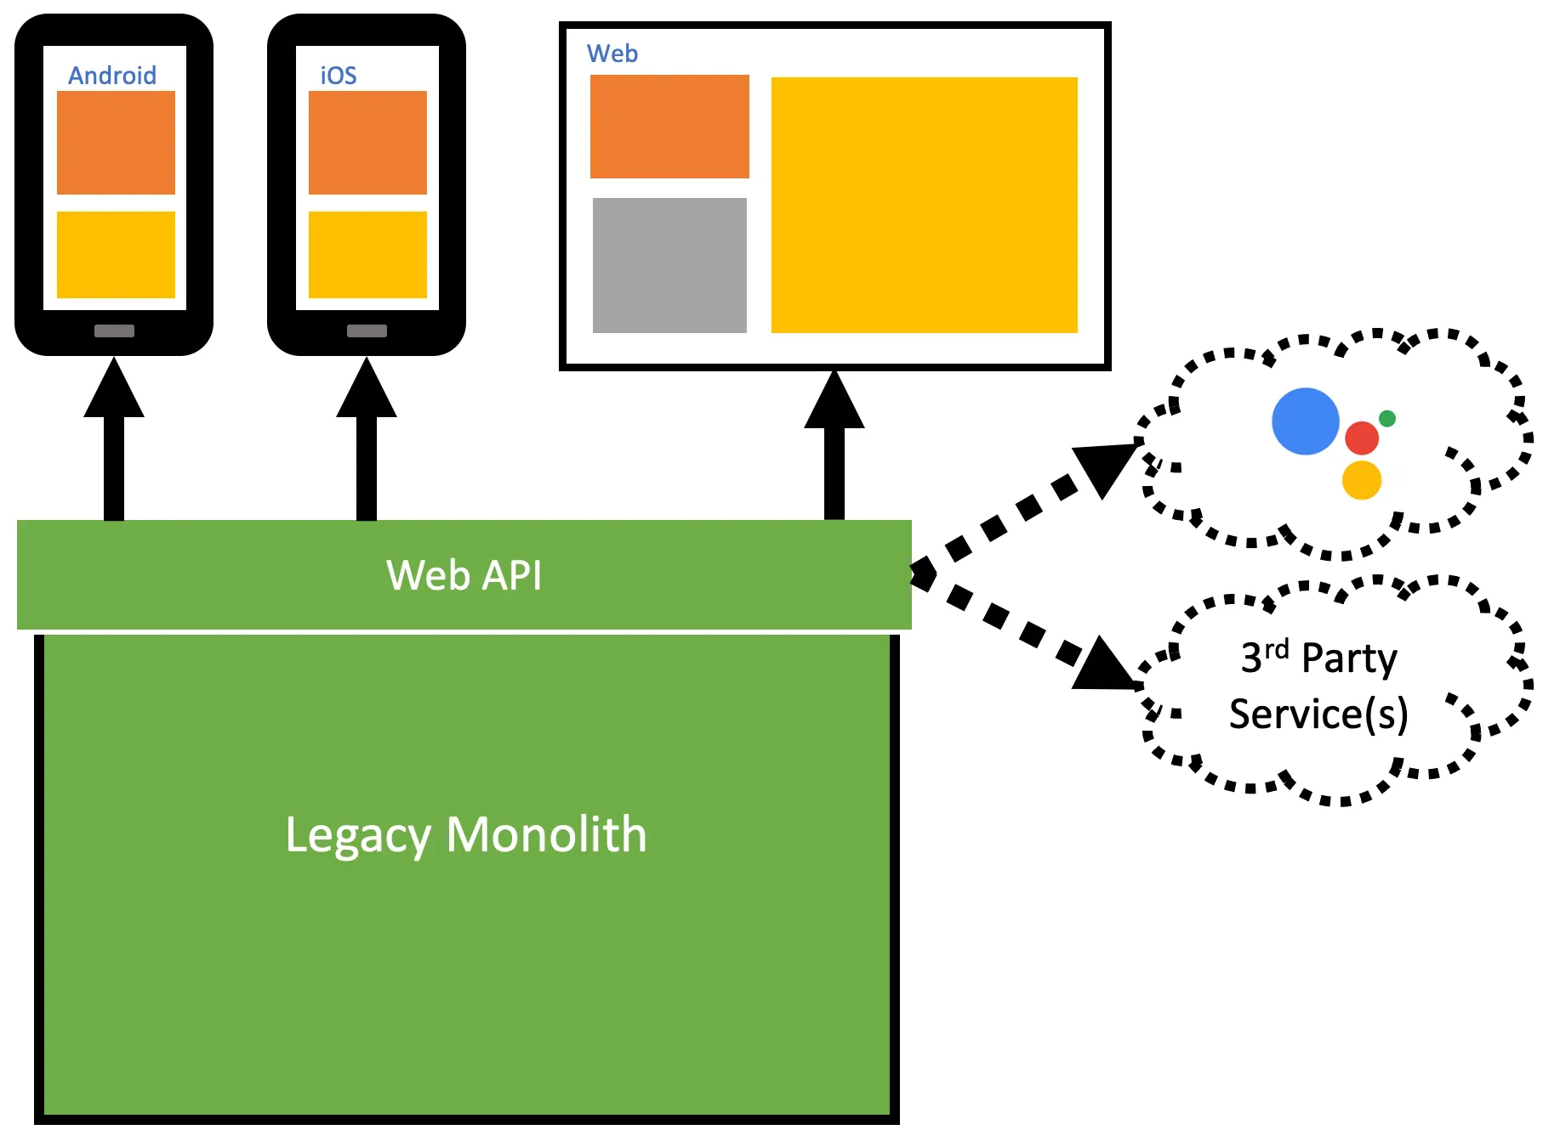
Backend for frontend (BFF)

Slide 23
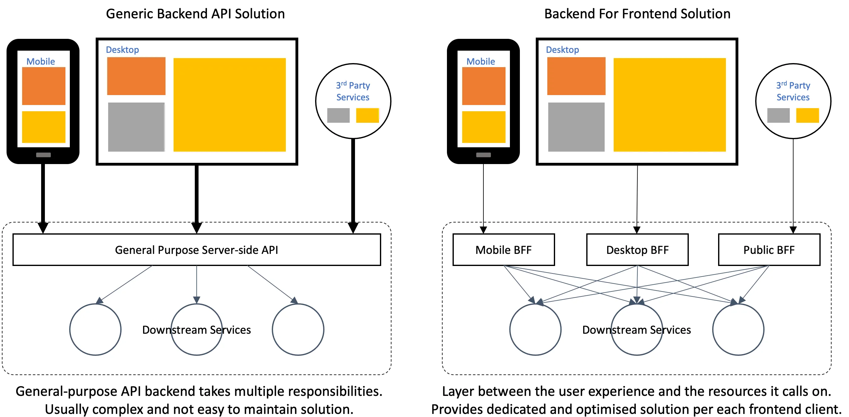
Backend for frontend (BFF)

Slide 24
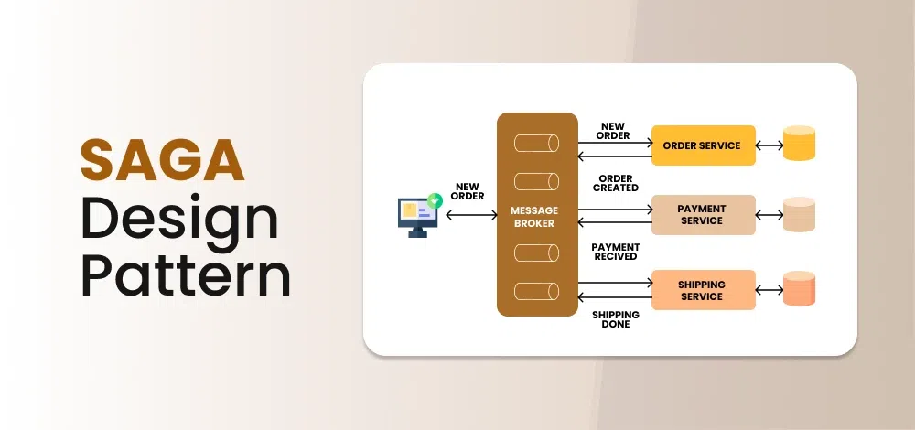

Slide 25
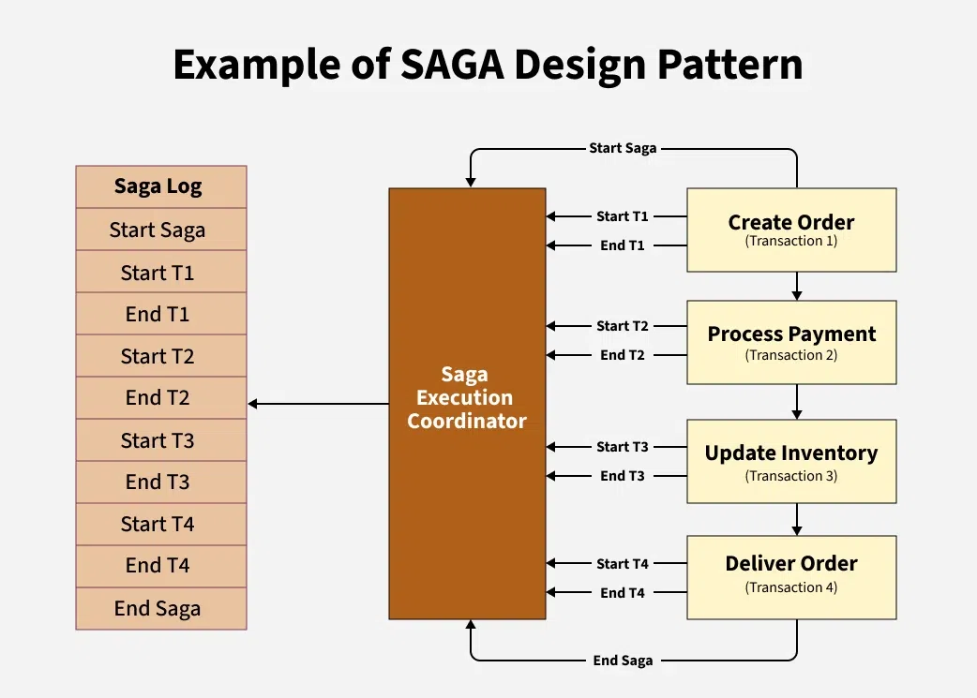

Slide 26
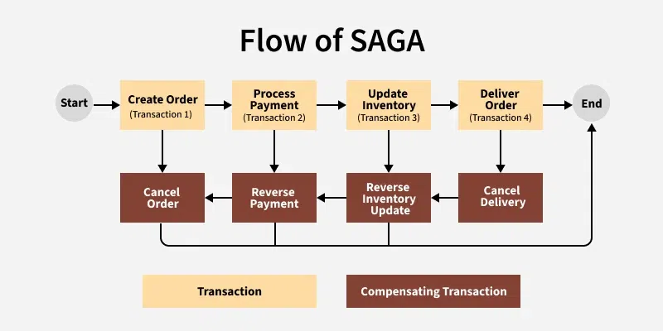

Slide 27
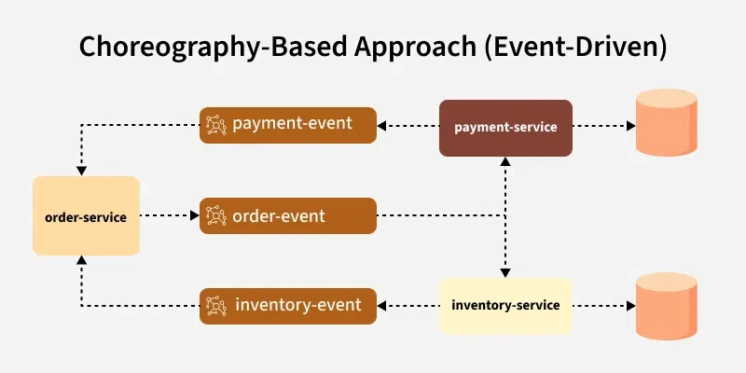

Slide 28
